Slide 1
Closed Loop Control
Anthony Corso

Slide 2
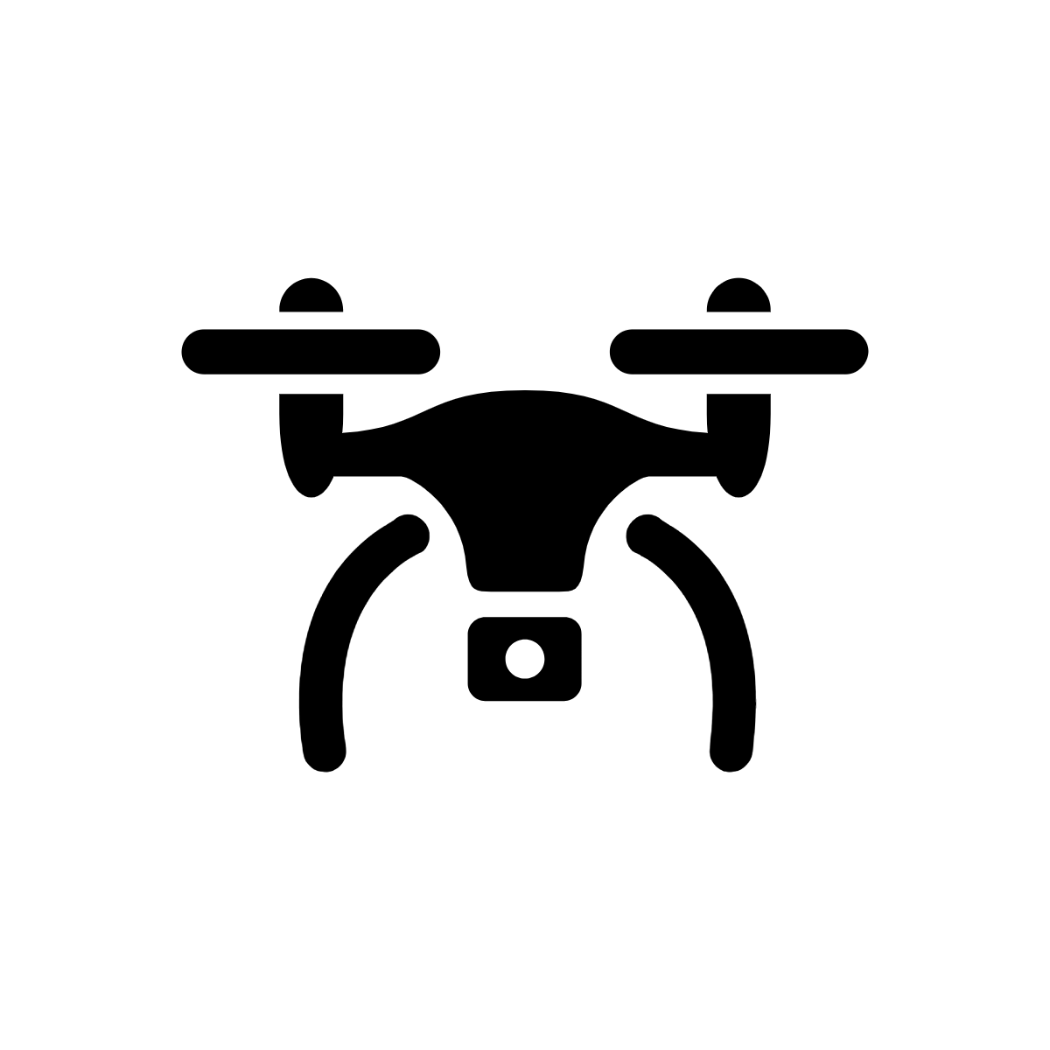
What do we mean by “closed” and “open”?
In open-loop control, we design a controller to take actions based on a set of fixed rules, which doesn’t respond to the state of the system
Controller
Tx, Ty
Position and Velocity

Slide 3
What do we mean by “closed” and “open”?
In closed-loop control, we design a controller to take actions based on the current error in the system
Position and Velocity
Tx, Ty
Controller
error
-
Desired position and velocity

Slide 4
Examples of closed-loop control?

Slide 5
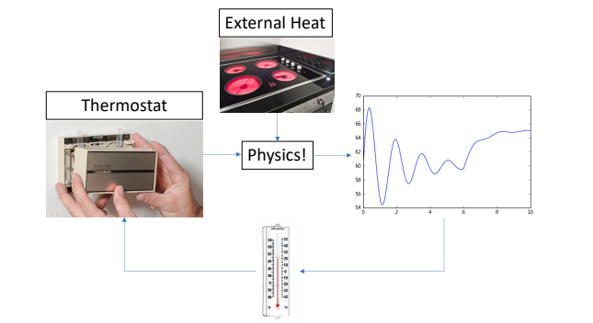
Thermostats!

Slide 6
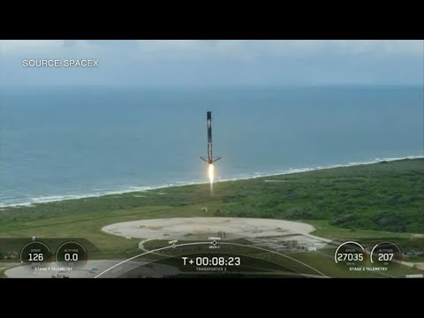
Launching and Landing Rockets

Slide 7
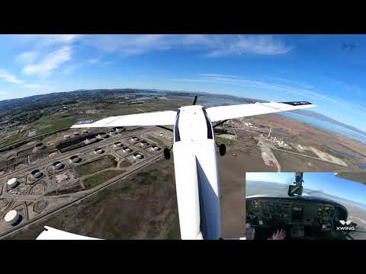
Autonomous flying

Slide 8
How do we design a closed-loop controller?
position
goal
Error = goal - position
What should we do if we have positive error?
Thrust to the right
Negative error?
Thrust to the left
What should we do if the error is larger in magnitude?
Apply more thrust
Lower in magnitude
Apply less thrust

Slide 9
How do we design a closed-loop controller?
position
goal
Error = goal - position
Thrust = Kp * error
Proportional Control:
“gain”

Slide 10
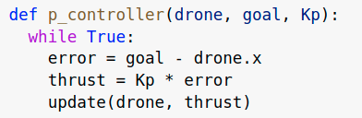
Proportional Control Pseudo-code

Slide 11
Proportional Control Gone Wrong
position
goal
Thrust
error

Slide 12
Proportional Control Gone Wrong
position
goal
Thrust
error

Slide 13
Proportional Control Gone Wrong
goal
position
Thrust
error

Slide 14
Proportional Control Gone Wrong
position
goal
Thrust
error

Slide 15
Proportional Control Gone Wrong
goal
position
Thrust
error

Slide 16
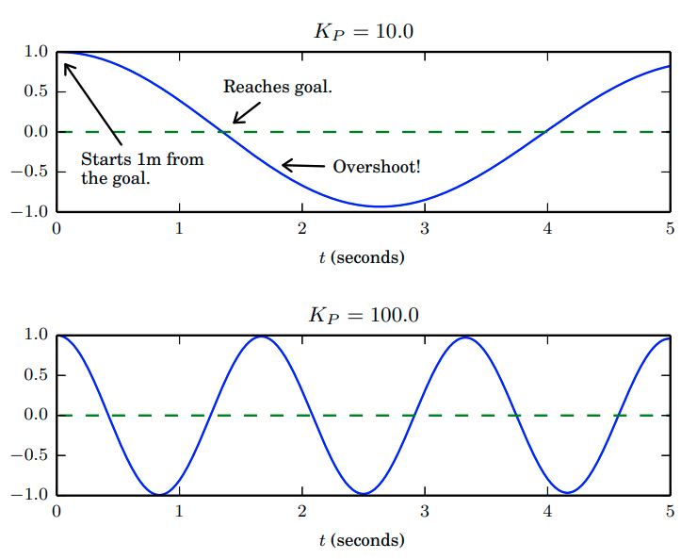
Proportional Control gone wrong
error
error

Slide 17
Derivative Control
The proportional controller is only considering the position of the drone not the drones speed.
position
goal
Thrust
error
What should we do if the error is decreasing?
Ease off!
What should we do if the error is increasing?
Add more control!

Slide 18
Derivative Control
Proportional term
Derivative term
Thrust = Kp * error
+ Kd * (change in error)
Thrust = Kp * error + Kd * (error - previous error)
What happens if the error is decreasing?
This term in negative so the total thrust is decreased
What happens if the error is increasing
This term in positive so the total thrust is increased

Slide 19
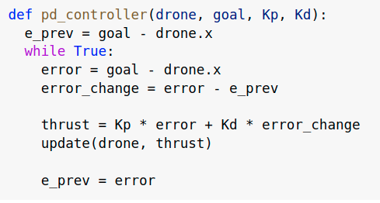
Derivative Control Code

Slide 20
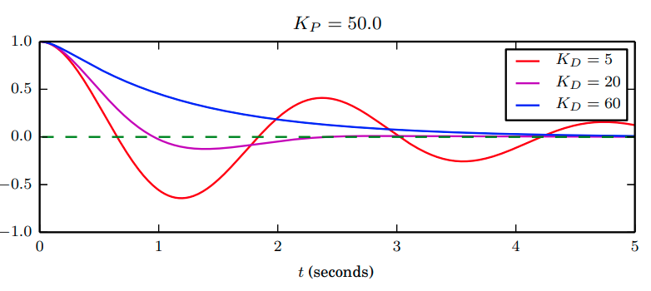
Derivative Control
error

Slide 21

Integral Control
What happens when we try to apply this controller in the presence of a strong headwind?
goal
Thrust
Wind
Thrust = Kp * error + Kd * (error - previous error)

Slide 22
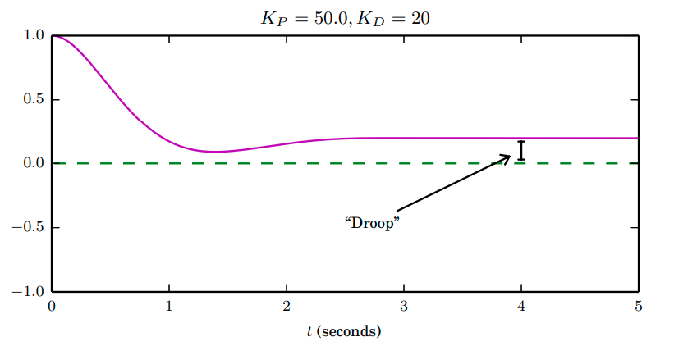
Integral Control
What happens when we try to apply this controller in the presence of a strong headwind?
The drone never quite reaches its goal position
error
Thrust
Wind

Slide 23
Integral Control
In integral control we add up all of the errors we have seen so far and use that for control:
Thrust = Kp * error +
Kd * (error - previous error) +
Ki * (sum of previous errors)

Slide 24
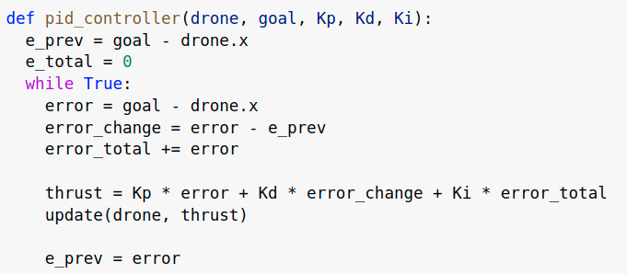
Integral Control Code

Slide 25
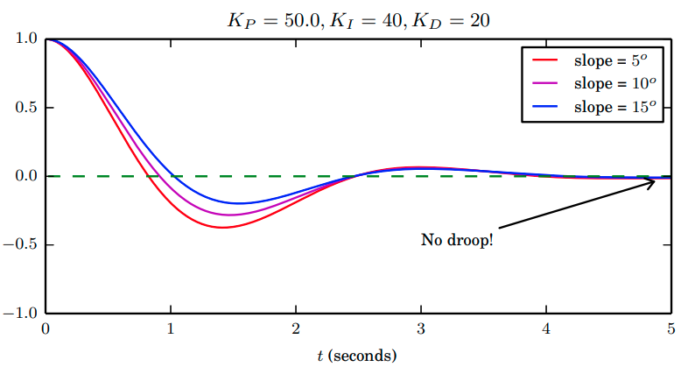
Integral Control
error

Slide 26
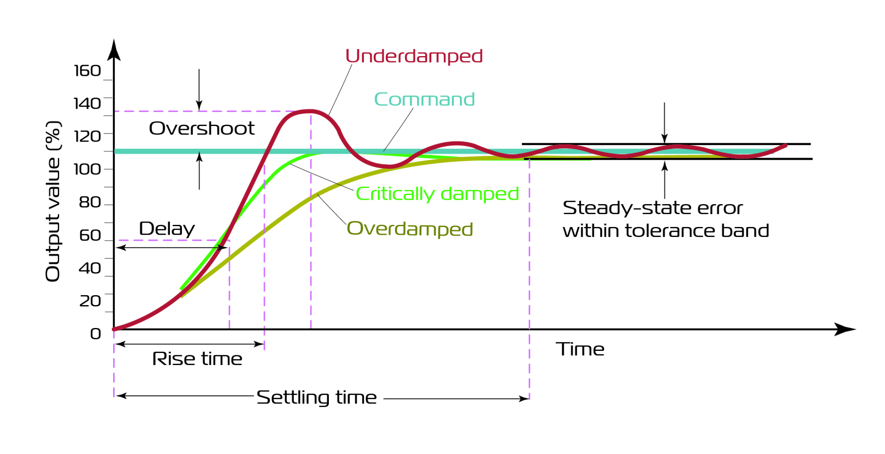
Choosing the gains

